Slide 1
Chapter 7 - The Research Design
authored by Stephanie Fleischer © SAGE publications Ltd 2014

Slide 2
Topics covered
What is a research design?
Functions of research design
Issues to consider when designing research
The theory of causality and the research design
authored by Stephanie Fleischer © SAGE publications Ltd 2014

Slide 3
What is a research design
Detailed plan of how the research study will be completed:
Operationalising variables
Selecting a sample
Selecting data collection methods
Selection analysis methods
Valid and reliable
Justified and supported by literature
authored by Stephanie Fleischer © SAGE publications Ltd 2014

Slide 4
Function of a research design
Conceptualise an operational plan to undertake the various procedures and tasks required to complete a study
Ensure that these procedures are adequate to obtain valid, objective and accurate answers to the research questions. Kerlinger calls this function the control of variance (1986: 280).
authored by Stephanie Fleischer © SAGE publications Ltd 2014

Slide 5
Research design
Specifying procedures clearly so that another researcher would be able to follow them exactly the same way. This should include:
Name of the study design (e.g. experiment, cross-sectional design, etc.)
Provide detailed information on study population, method of data collection, analysis methods and ethical issues
authored by Stephanie Fleischer © SAGE publications Ltd 2014

Slide 6
The theory of causality and the research design
When examining a cause-effect relationship:
Study the impact on the independent variable
Study the cause of change on the dependent variable
Consider other affecting variables (extraneous variables) by using a control group to quantify the impact
Consider random or change variables (changes in the dependent variable) due to mood of respondents or ambiguity of research instrument
authored by Stephanie Fleischer © SAGE publications Ltd 2014

Slide 7
Changes in the dependent variable may be attributed to three types of variables
Insert image of updated boxes (p97, third edition): Changes in the dependent variable = changes attributable to independent variable ± change attributable to extraneous variables ± change attributable to chance and random variables
authored by Stephanie Fleischer © SAGE publications Ltd 2014

Slide 8
Building into the design
Ensure that extraneous variables have a similar impact on control and experimental groups:
Randomisation
Matching
Two methods for extraneous variables:
Build the affecting variable into the design of the study
Eliminate the variable
authored by Stephanie Fleischer © SAGE publications Ltd 2014

Slide 9
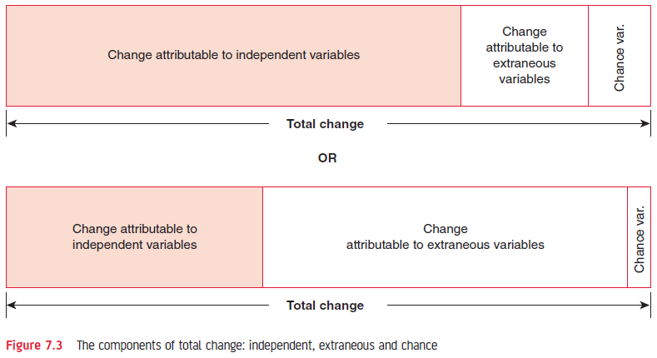
Figure 7.3 The proportion attributable to the three components may vary markedly
authored by Stephanie Fleischer © SAGE publications Ltd 2014

Slide 10
Summary: Function of research design
Stating the procedures for undertaking the study in detail
Ensuring that the independent variable has the maximum opportunity to have its effect on the dependent variable while the effect of extraneous and change variables is minimised in a cause-effect relationship
authored by Stephanie Fleischer © SAGE publications Ltd 2014

